Slide 1
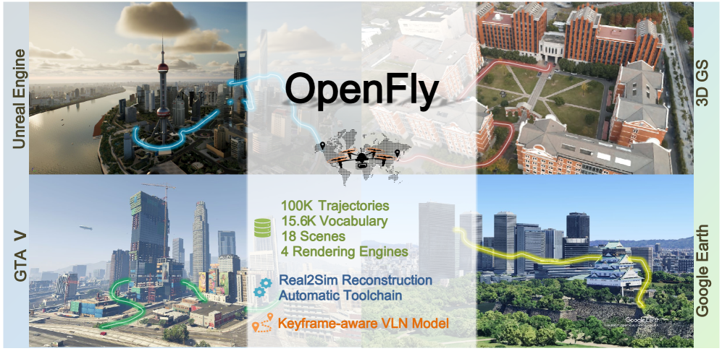
OpenFly: A Comprehensive Platform for Aerial Vision-Language Navigation
Dr. Peng Jiang Lab
Presented by: Dev Patel
Computer Science in Artificial Intelligence

Slide 2
Introduction
Vision-Language Navigation (VLN) is a core problem in embodied AI, where an intelligent agent must follow natural language instructions while interpreting its surrounding visual environment.
Prior works have made significant progress in indoor and ground-based VLN tasks, aerial setting using drones remains largely unexplored. This is critical because UAVs have enormous potential applications in areas like rescue operations, aerial mapping, and cargo delivery.
To address these limitations, the authors propose OpenFly, a unified platform that integrates multiple rendering engines, an automated data generation toolchain, and a large-scale benchmark dataset, setting the stage for advancing aerial VLN research.
Notes:
Firstly, we integrate diverse rendering engines and advanced techniques for en-
vironment simulation, including Unreal Engine, GTA V, Google Earth, and 3D
Gaussian Splatting (3D GS). Particularly, 3D GS supports real-to-sim render-
ing, further enhancing the realism of our environments. Secondly, we develop
a highly automated toolchain for aerial VLN data collection, streamlining point
cloud acquisition, scene semantic segmentation, flight trajectory creation, and in-
struction generation. Thirdly, based on the toolchain, we construct a large-scale
aerial VLN dataset with 100k trajectories, covering diverse heights and lengths
across 18 scenes. Moreover, we propose OpenFly-Agent, a keyframe-aware VLN
model emphasizing key observations during flight. For benchmarking, extensive
experiments and analyses are conducted, evaluating several recent VLN methods
and showcasing the superiority of our OpenFly platform and agent. The toolchain,
dataset, and codes will be open-sourced.

Slide 3
Objectives
OpenFly Platform: Integration of multiple rendering engines (Unreal Engine, GTA V, Google Earth, 3D Gaussian Splatting).
Automated Toolchain: Streamlined pipeline for point cloud acquisition, semantic segmentation, trajectory generation, and instruction generation.
Large-Scale Dataset: 100K trajectories, 18 diverse scenes, and a vocabulary of 15.6K — the largest aerial VLN benchmark to date.
OpenFly-Agent Model: A keyframe-aware VLN model that emphasizes critical observations and reduces redundancy through visual token merging.
Comprehensive Benchmarking: Extensive experiments comparing recent VLN methods, showing superior performance and strong real-to-sim generalization

Slide 4
Methodology-Data Collection
Rendering Engines
Unreal Engine (UE4/UE5), GTA V, Google Earth, 3D Gaussian Splatting (3D GS)
Provides diverse, photorealistic aerial environments
Automated Toolchain
Point Cloud Acquisition
Semantic Segmentation
Trajectory Generation
Instruction Generation
Dataset Split
Train: Majority from UE + 3D GS scenes
Test-Seen: Trajectories from previously used scenes
Test-Unseen: New environments (UE-smallcity, 3DGS-sjtu02, GTA V city)

Slide 5
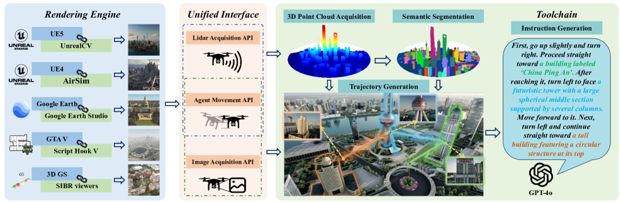
Automated Toolchain
Point Cloud Acquisition: Rasterized sampling (Unreal Engine, GTA V). Sparse reconstruction via COLMAP (3D Gaussian Splatting)
Scene Semantic Segmentation: Octree-Graph for 3D scene understanding. Point cloud projection + contour extraction (OpenCV).Optional manual annotation for refinement
Automatic Trajectory Generation: Builds global voxel map (Mglobal). Chooses landmarks + start/end points. Uses A* pathfinding for collision-free UAV paths. Supports variable step sizes (3m, 6m, 9m forward moves)
Instruction Generation: Keyframe extraction at action changes. Sub-trajectory segmentation → GPT-4o generates sub-instructions. Sub-instructions fused into full trajectory description. Post-processing with NLTK + embeddings to remove redundancy

Slide 6
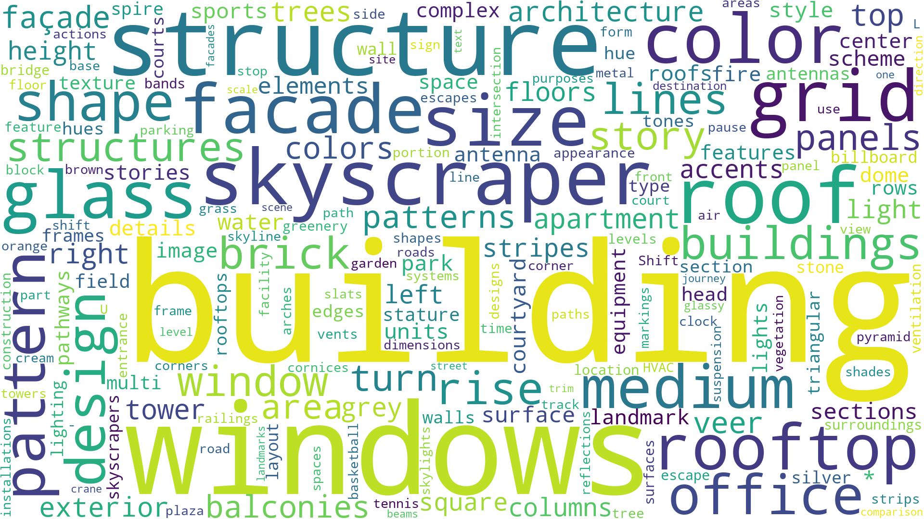
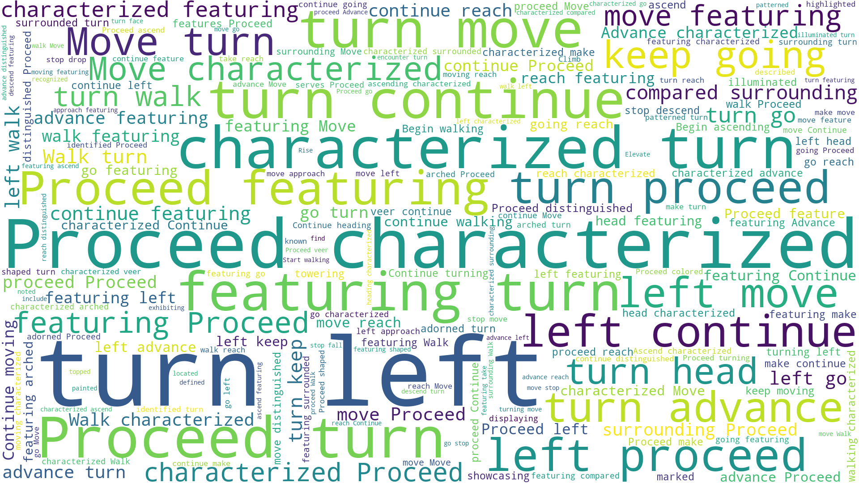
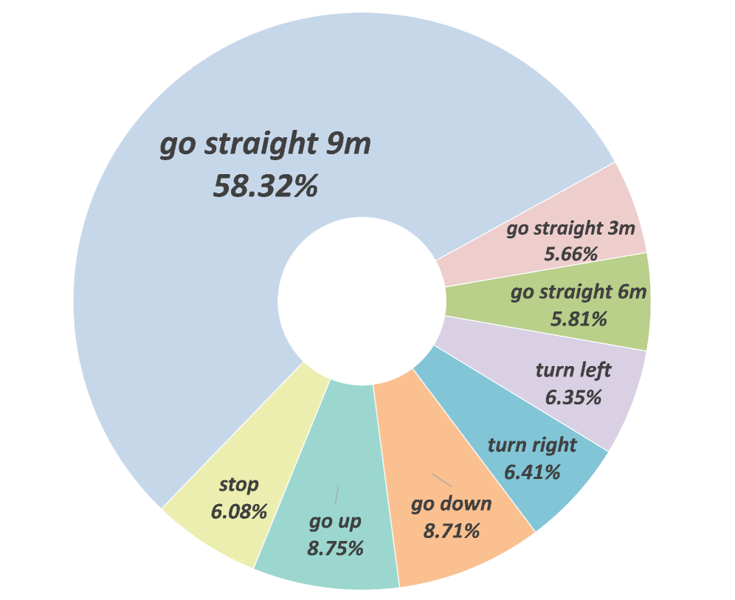
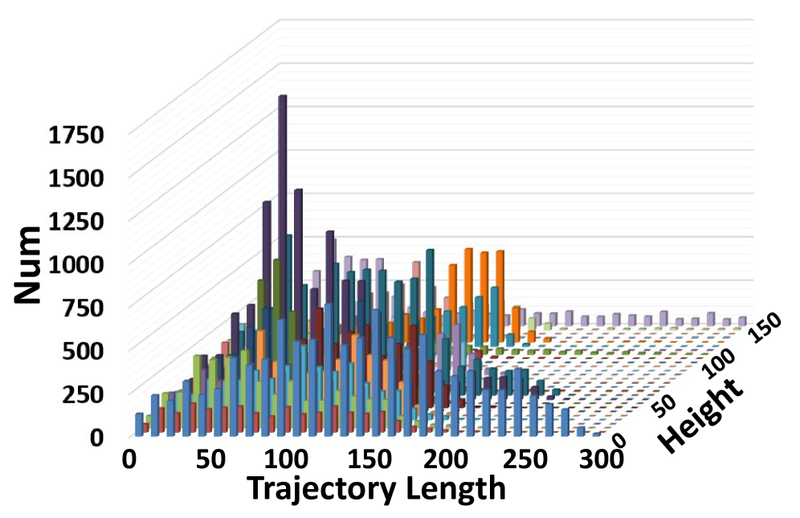
Dataset Analysis
Scale & Diversity
100,000 UAV trajectories
18 scenes across UE, GTA V, Google Earth, 3D GS
Wide variation in altitudes (0–150m) and trajectory lengths (0–300m)
Language Characteristics
Vocabulary size: 15.6K unique words
Avg. instruction length: 59 words
Rich linguistic phenomena (reference, sequencing, egocentric relations)
Action Distribution
Actions: Forward, Turn Left, Turn Right, Ascend, Descend, Stop
Forward dominates → mitigated using multiple granularities (3m, 6m, 9m)
Quality Assurance
Random sample inspection of 3K instructions
91% qualification rate after manual review
Dataset Split
Train: 7 UE + 4 3D GS scenes (≈95% of data)
Test-Seen: 1.8K trajectories from seen scenes
Test-Unseen: 1.2K trajectories from new scenes (UE-smallcity, 3DGS-sjtu02, GTA V city)

Slide 8
Thank You!
Questions.?

